Slide 1
What You Need to Know to Get a Driver Privilege Card in Virginia
Presentation Prepared by the
Virginia Department of Motor Vehicles

Slide 2
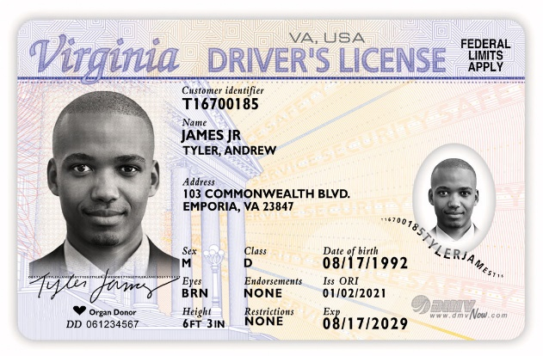
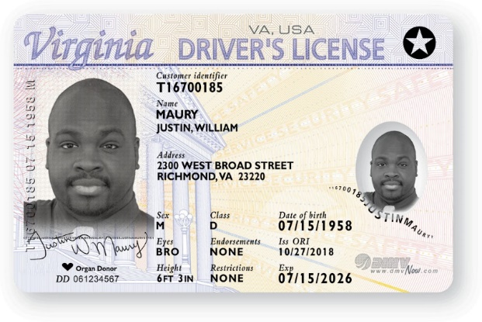
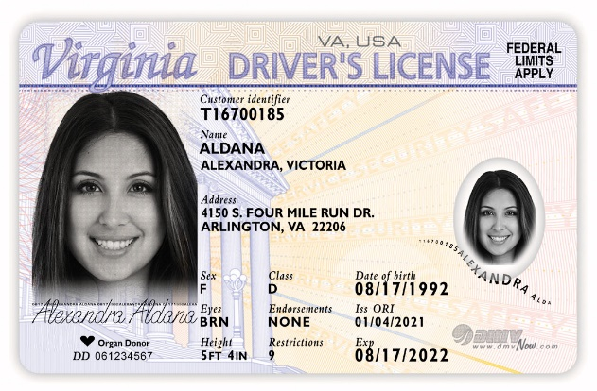
Three Types of Driving Credentials
STANDARD
REAL ID
DPC

Slide 3
Difference Between the Cards
Proof of Legal Presence
DPC holders do not present legal presence documents; all other card holders do
Proof of Reported Income
DPC holders must show proof of reported income from Va. sources or show they’ve been claimed as a dependent on Va. tax return in past 12 months

Slide 4
Requirements for Applying for a DPC
Present several documents
Take specified testing
Pay a $50 or $53 fee
Hold a learner’s permit for 60 days, unless can show proof you hold or have held a license
Customers who have an expired Virginia driver's license or hold a license/DPC issued by another state will not be required to retest.
No current suspensions or revocations, including insurance-related infractions

Slide 5
Required Documents
Two Proofs of Identity
Common examples include:
A foreign passport not expired more than five years
A secure driver’s license issued by another state or country not expired more than five years
A foreign birth certificate

Slide 6
Required Documents
Proof of Social Security Number or Individual Taxpayer Identification Number
Common examples include:
Social Security Card
ITIN Letter

Slide 7
Required Documents
Two Proofs of Virginia Residency
Common examples include:
A bank or credit card statement
A mortgage statement or rental lease agreement
A paystub
The proof of Virginia residency document must display the applicant’s name and current residential street address, no P.O. boxes.

Slide 8
Required Documents
Documentation of Virginia Tax Return
A common example:
A Virginia Resident Form 760 – Individual Income Tax Return – filed within the past 12 months
DMV will verify reported income and deductions with the Virginia Department of Taxation.
Dependents must provide an acceptable Virginia form along with the corresponding federal tax return document filed by their parent or guardian listing them as a dependent and filed in the past 12 months.

Slide 9
Make Your Appointment
Visit dmvNOW.com to schedule a knowledge test
Knowledge testing is available in 20+ languages, including:
* Spanish * Chinese Mandarin * Russian
* Arabic * Amharic * Farsi
* Dari * French * Turkish
* Vietnamese * Nepali * Urdu

Slide 10
Make Your Appointment
Visit dmvNOW.com to schedule a road skills test or complete an approved driver education program
Can bring someone to help with translation

Slide 11
Visit dmvNOW.com/dpc
for more information.

